Slide 1
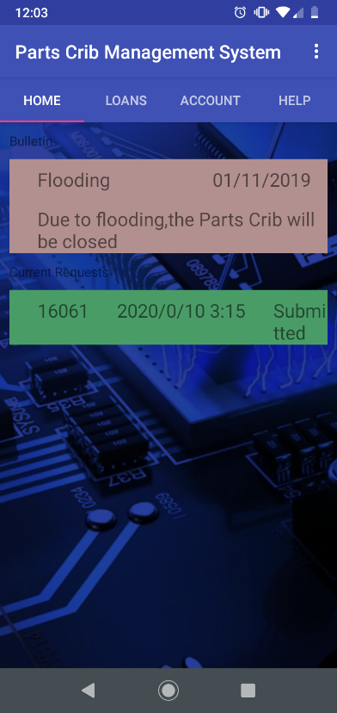
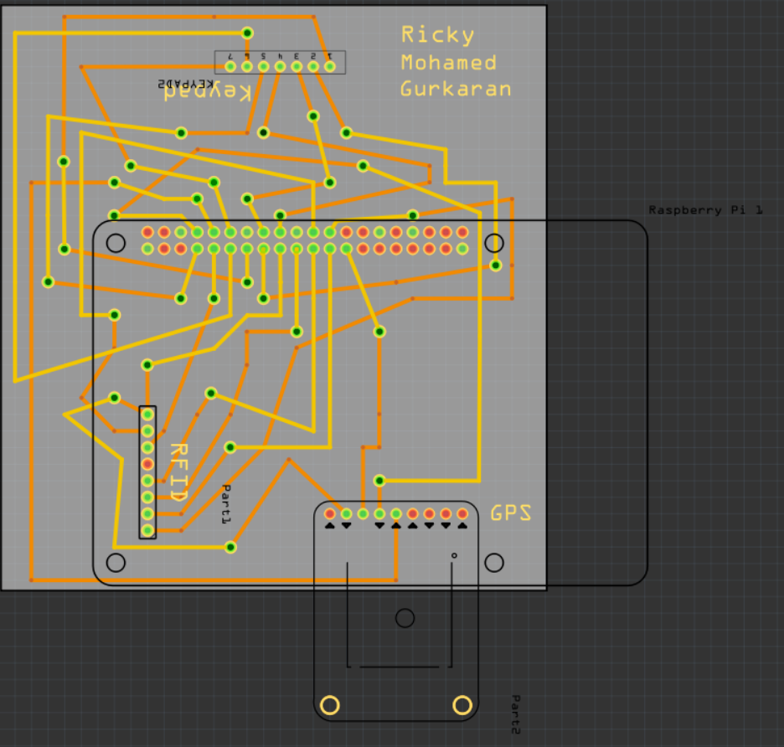
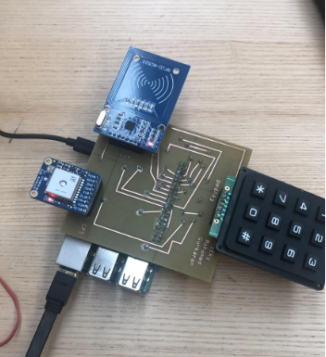
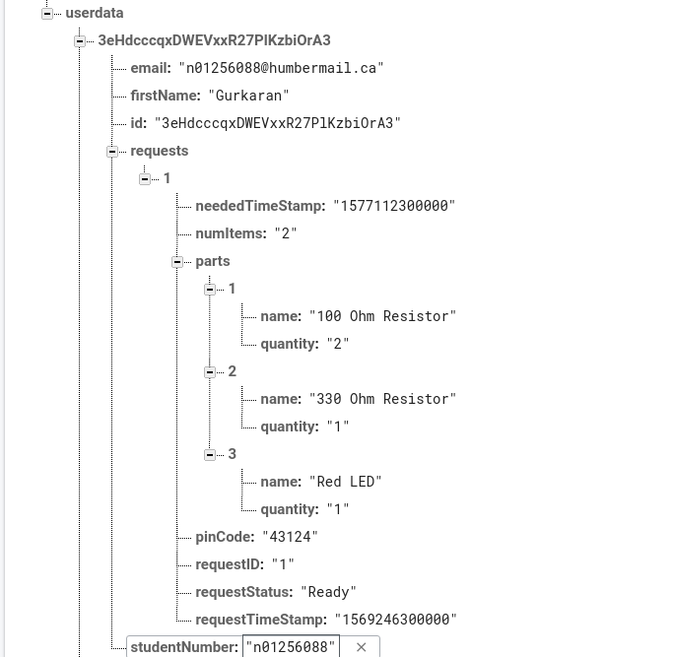


Parts Crib Management System
Gurkaran Padda, Mohamed Kore, Ricky Ramnath
INTRODUCTION
The parts crib management system will implement a system that will allow the parts crib to keep an electronic catalogue of items loaned out to students. Students will be able to use a mobile android-based application to see what items are available and to request them using their student credentials. An RFID Scanner, GPS Sensor, and a Keypad System will allow us to achieve this. Our goal is to make this a more efficient and easier way of borrowing parts from the parts crib. It is a goal of our group to make this project industry worthy for any application. We are assuming we’re capable of putting RFID tags on everyone’s student ID in the parts management system. We can also assume that the inventory of the parts crib is given to us so we’re able to put it into our database for when it comes to distribution of parts. We’re dependent on the Admins at the parts crib to be able to read the system and be able to handle the intake of item requests given to them by the users.
METHOD
We have integrated our most of our components into a single board and have updated our codes into a single python script. The code we’ve implemented allows the RC522 RFID to read inputs from the RFID chip and print it to the screen with included details such as the unique ID of each chip and will eventually display necessary information from the database like name and a list of signed out components. It also allows the GPS Breakout to write real time updates of location to the screen, which will be implemented to retrieve data such as sign-out times from the database. Finally, the code for the Keypad allows input into the script, which will be eventually integrated into the database authentication component. The updated code including all of components can be found at our GitHub repository. In terms of progress of troubleshooting our code, we’ve resolved any big issues and will likely troubleshoot any remaining errors while also cleaning up the code and have them corrected by the deadline. As for finance, our budget has not changed, and no added costs have taken place since the declaration of our required resources.
RESULTS
We produced four main views/tabs that the user should need on the mobile app, and we should keep it no more than four in order to avoid confusion. The four views we decided on for the mobile app was a home tab, a loans tab, a account tab, and a help tab, any other small details that we would need or plan on implementing in the future can be put into the settings menu.
We have finished the creation of the app and database. When items gets requested on the app, it gets sent to the database when there it will be stored and associated with a unique iq, the name of the requested item, timestamps, and a unique code. All of this is stored in a category that holds information such as humber email address, student name, student number, an a iq number associated with the order. The app is fully functional along side of the database.
PRINTING
AIM
There will be many parts, components, and materials that will be used in this project. Firstly, there will be the sensors which include; the radio frequency identification scanner, global position sensor, and a twelve-button keypad. Each sensor and effector will be a key asset to this project. Some materials that will be used will include, laser cut acrylic, fiberglass epoxy resin with a copper foil bonded on to one or both sides for our PCB boards and acrylonitrile butadiene styrene plastic for the three-dimensional printed parts that will be used with the acrylic to make a feasible enclosure to house our sensors. For our development platform, we will be using a raspberry pi three model b. This will all be housed in the enclosure made from acrylic. Some additional accessories that will enhance the features of the project will include; radio frequency identification tags for attaching to parts to scan in or out for inventory control, and an external active global position sensor antenna that will allow the sensor to have a boosted signal to get a position fix more faster and efficiently. Most of the tools required for testing the hardware, are either already given to us in our classroom or we already have it with us at all times in our toolboxes. For testing on our hardware’s PCB Board, we will be using multimeters in order to find any connection continuity errors. Some other components that we may need to borrow for our hardware design, such as the helping hand for holding the PCB board, will be acquired from the parts crib.
CONCLUSIONS
We had planned on developing a web-based media designed for the use for employees behind the parts crib in order to manage inventory and regulate orders. As of now there’s no foreseeable deployment of the Parts Crib management system happening due to the events currently happening.
Frizting PCB
General concept
Home Menu Activity along
With other major tabs
Flood activity for when the parts crib is closed
Finalized PCB board
With our sensors
ACKNOWLEDGEMENTS
Database with info being sent from the application
There are subcategories for students and their requested parts

Slide 2
Commonly used logos

